Slide 1
Finding Jobs for students with disabilities
A practical step by step guide for educators

Slide 2
“Every job is a self-portrait of the person who did it. Autograph your work with excellence.”
Anonymous

Slide 3
What is meaningful employment?
Self-Discovery
Know self
Know strengths
Know who can help you plan your career, occupation ,job
Create a Personal Action Plan
Source: “6 Easy Steps to Identify Meaningful Employment”- CEA Resource upload

Slide 4
How can students market themselves?
Personal Branding
Create a 30 second Elevator Pitch
Personalized Business Cards with contact information
Choose a Functional, Visual, or Chronological Resume*
*Source: The Best Damn Good Resume Guide: “A crash Course in Resume Writing”- Yana Parker Ten Speed Press Berkley

Slide 5
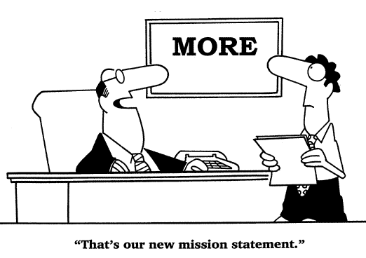
How can schools prepare students for careers, occupations, jobs?
Understand workplace culture
Meeting new people
Satisfy employer expectations
Student adding value to the workforce.
College or continuing education track support
Source: “ 30 Ways to Shine as a New Employee”- Denise Bissonnette Milt Wright &Associates

Slide 6
Let’s begin the job search…
Create a Job Search Plan

Slide 7
Job Search plan
Student generated…
Actively involved in exploring
and searching for jobs in their
communities.
Student to find interesting
job postings
Bring in application forms
On-line practice with web based applications
Student to talk to family and friends for job ideas
Make a list of questions to ask an employer on interview

Slide 8
Building Networks
#1 Way to get exposure to find jobs.
Networking…
What is it really?
Building mutually beneficial relationships
Gaining visibility
Information gathering

Slide 9
Networking works
Increases credibility
Capitalizes on relationships
Direct line to those who hire
Increases understanding and support
Head start on competition

Slide 10
Student Networks
Friends, family, neighbors
School staff, teachers, administrators, other school staff
Places in students’ community
Frequent places they like to eat, shop, recreate…
What are the possibilities in preferred settings?

Slide 11
Job Search Strategies
O*NET
CEA
Job Opportunity Board
DLT website
EmployRI
Youth Portal
For experiential learning look into Exchange City 2.0 by Education in Action.
Assist students develop questions about careers, occupations, jobs they’re interested in exploring …

Slide 12
“The most powerful thing we can do to change our lives is to change the way we think” - William James

Slide 13
Resources
“30 Ways to shine as an Employee” Denise Bissonette
“The Damn Good Resume Writing Guide”
Yana Parker
“6 Easy Steps to Meaningful employment”
Center for Excellence and Advocacy
Create your own elevator pitch at

